Slide 1
communityToolkit
https://www.youtube.com/watch?v=uVIzK2snugk

Slide 2
First create TextBlock and a button in the main window.
<Window x:Class="CommunityToolkit_example.MainWindow"
xmlns="http://schemas.microsoft.com/winfx/2006/xaml/presentation"
xmlns:x="http://schemas.microsoft.com/winfx/2006/xaml"
xmlns:d="http://schemas.microsoft.com/expression/blend/2008"
xmlns:mc="http://schemas.openxmlformats.org/markup-compatibility/2006"
xmlns:local="clr-namespace:CommunityToolkit_example"
mc:Ignorable="d"
Title="MainWindow" Height="450" Width="800">
<Grid VerticalAlignment="Center" HorizontalAlignment="Center">
<StackPanel>
<TextBlock Margin="5"/>
<Button Content="Click Me" Margin="5"/>
</StackPanel>
</Grid>
</Window>

Slide 3
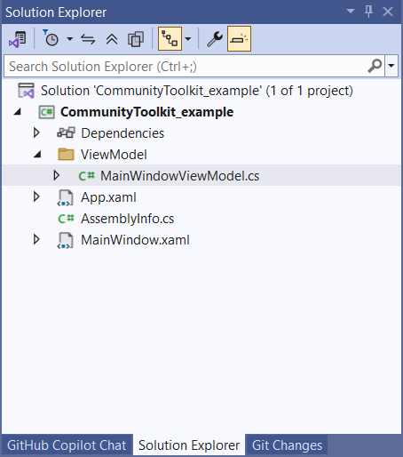
Add the MainWindowViewModel class.
Create a new Property FirstName in the MainWindowViewModel.cs, and assign it a value.
Add binding to the TextBlock to link FirstName in MainWindow.xaml. This will not work (see the three dots). You need to add the data context to create the link.
using System;
using System.Collections.Generic;
using System.Linq;
using System.Text;
using System.Threading.Tasks;
namespace CommunityToolkit_example.ViewModel
{
internal class MainWindowViewModel
{
public string? FirstName { get; set; } = "Daniel";
}
}

Slide 4

Add binding to the TextBlock to link FirstName. This will not work yet, because a DataContext needs to be created.
You can find the binding does not work by the three dots.
In the xaml Window add the data context as shown below:
<Window x:Class="CommunityToolkit_example.MainWindow"
xmlns="http://schemas.microsoft.com/winfx/2006/xaml/presentation"
xmlns:x="http://schemas.microsoft.com/winfx/2006/xaml"
xmlns:d="http://schemas.microsoft.com/expression/blend/2008"
xmlns:mc="http://schemas.openxmlformats.org/markup-compatibility/2006"
xmlns:local="clr-namespace:CommunityToolkit_example"
mc:Ignorable="d"
xmlns:VM="clr-namespace:CommunityToolkit_example.ViewModel"
d:DataContext="{d:DesignInstance Type=VM:MainWindowViewModel}"
Title="MainWindow" Height="450" Width="800">

Slide 5
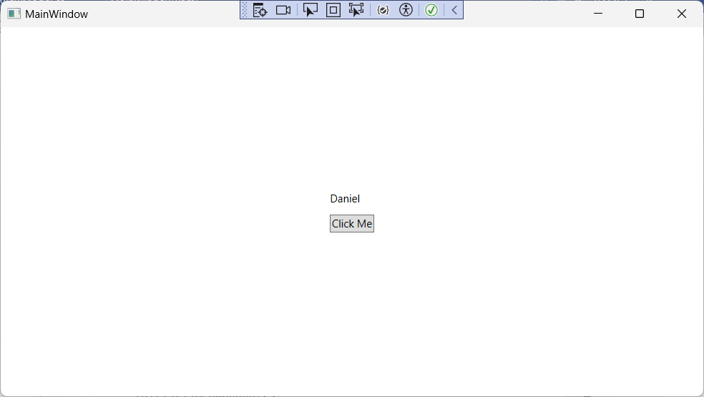
You also need to assigne the new MainWindowViewModel to the DataContext in MainWindow.xaml.cs
When you start the program you will see that the assigned value to FirstName is shown in TextBlock
using System.Text;
using System.Windows;
using System.Windows.Controls;
using System.Windows.Data;
using System.Windows.Documents;
using System.Windows.Input;
using System.Windows.Media;
using System.Windows.Media.Imaging;
using System.Windows.Navigation;
using System.Windows.Shapes;
using CommunityToolkit_example.ViewModel;
namespace CommunityToolkit_example
{
public partial class MainWindow : Window
{
public MainWindow()
{
DataContext = new MainWindowViewModel();
InitializeComponent();
}
}
}

Slide 6
Add interaction
Create a new private property called ViewModel and then assign it to DataContext
<Button Content="Click Me" Margin="5" Command="{Binding ClickCommand}"/>
namespace CommunityToolkit_example
{
public partial class MainWindow : Window
{
private MainWindowViewModel ViewModel { get; }
public MainWindow()
{
ViewModel = new MainWindowViewModel();
DataContext = ViewModel;
InitializeComponent();
}
}
}

